Slide 1

Notes:
Intro

Slide 2

Notes:
Intro

Slide 3
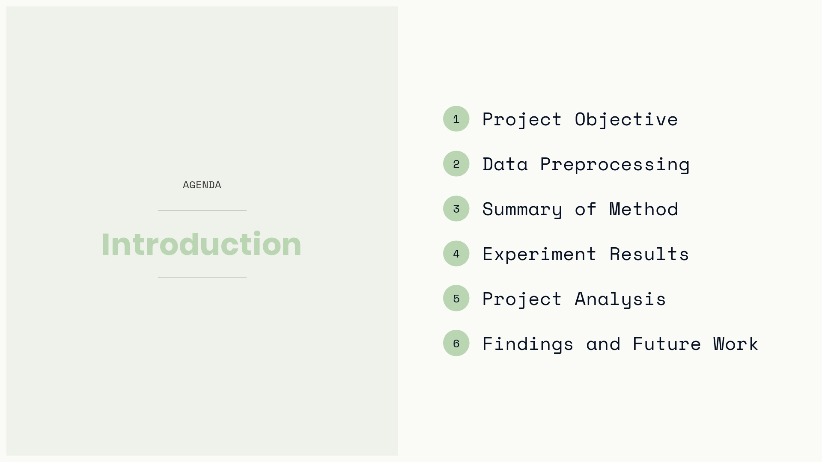
Notes:
Intro

Slide 4
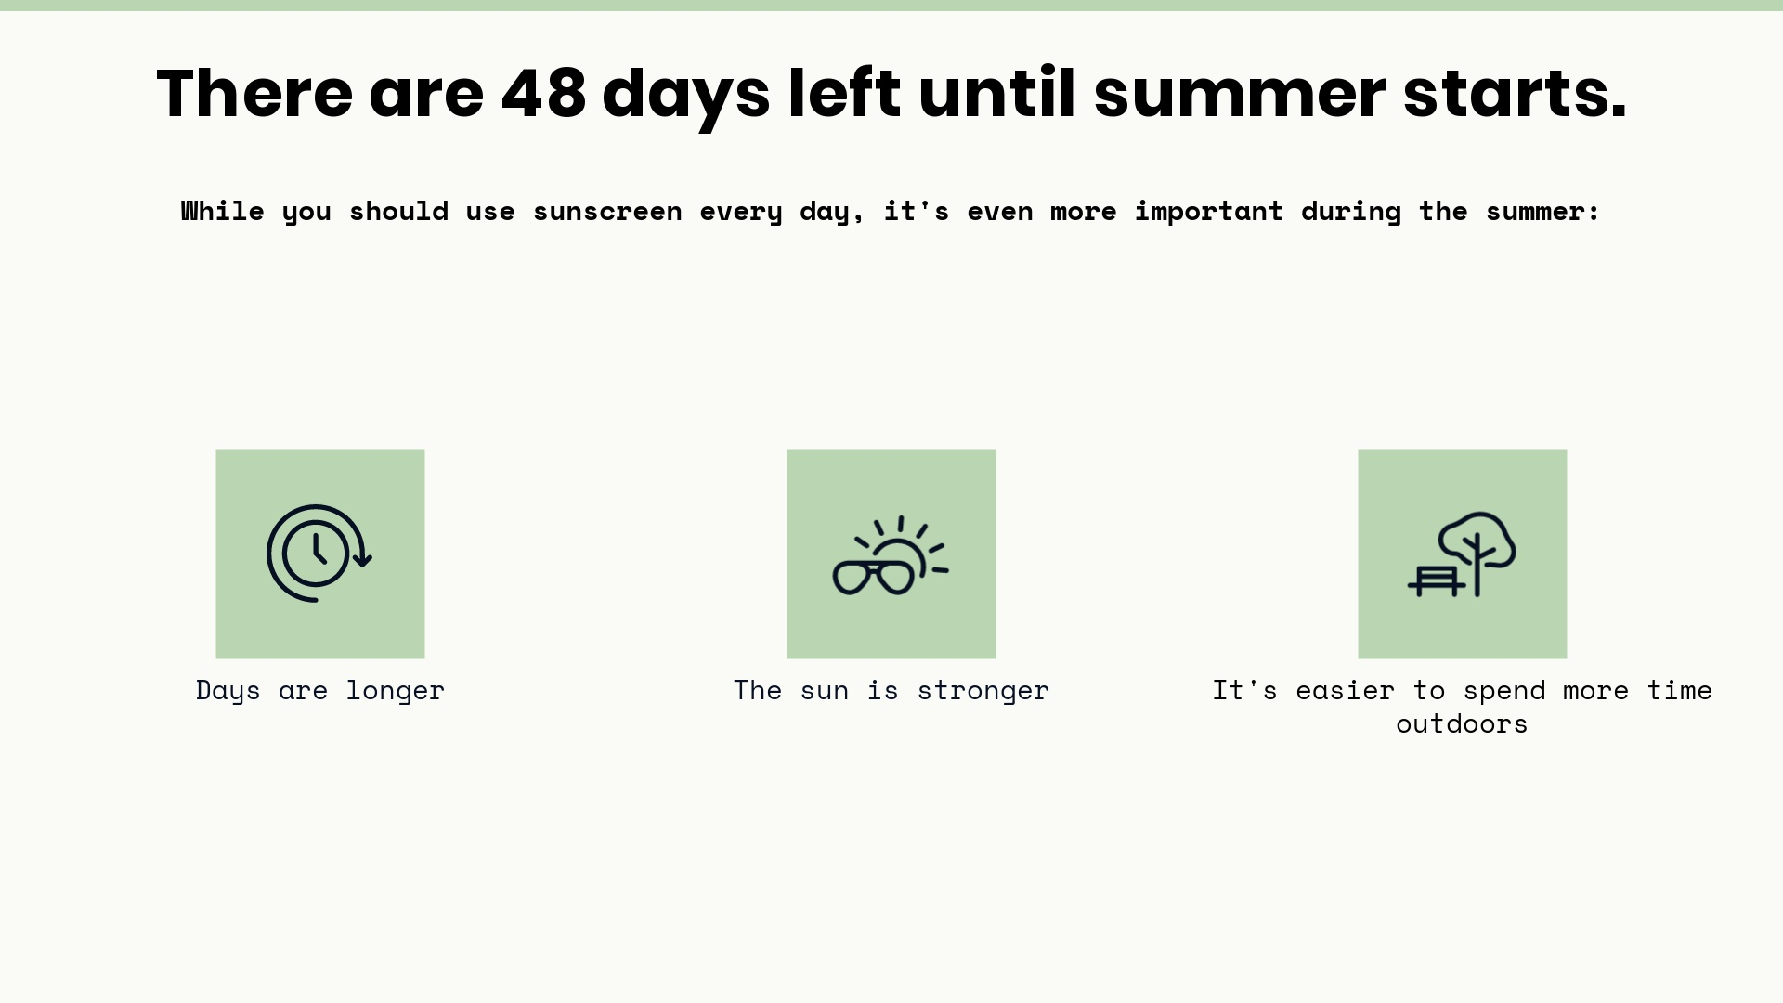
Notes:
Intro

Slide 5
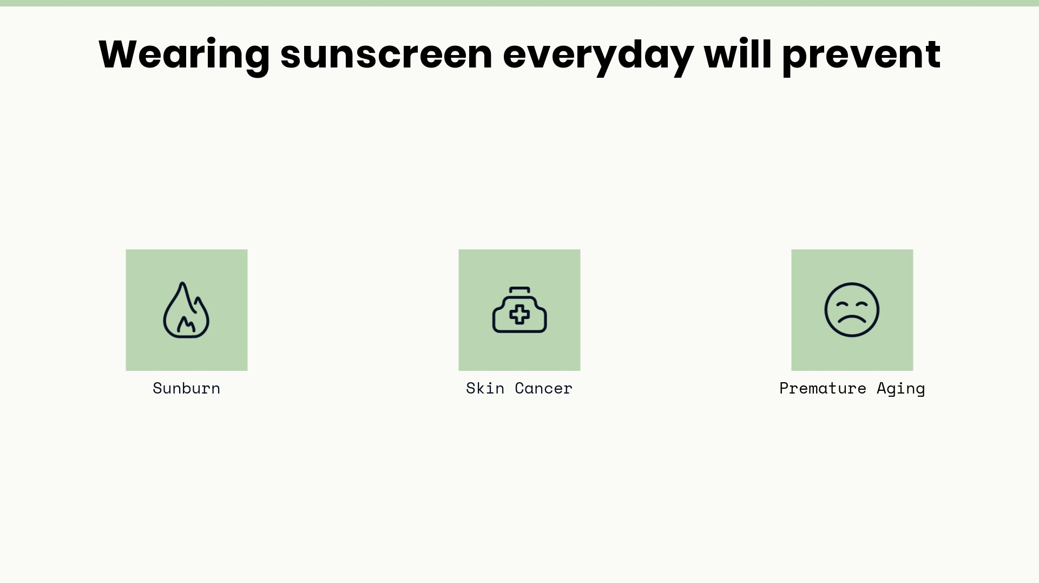
Notes:
Intro

Slide 6
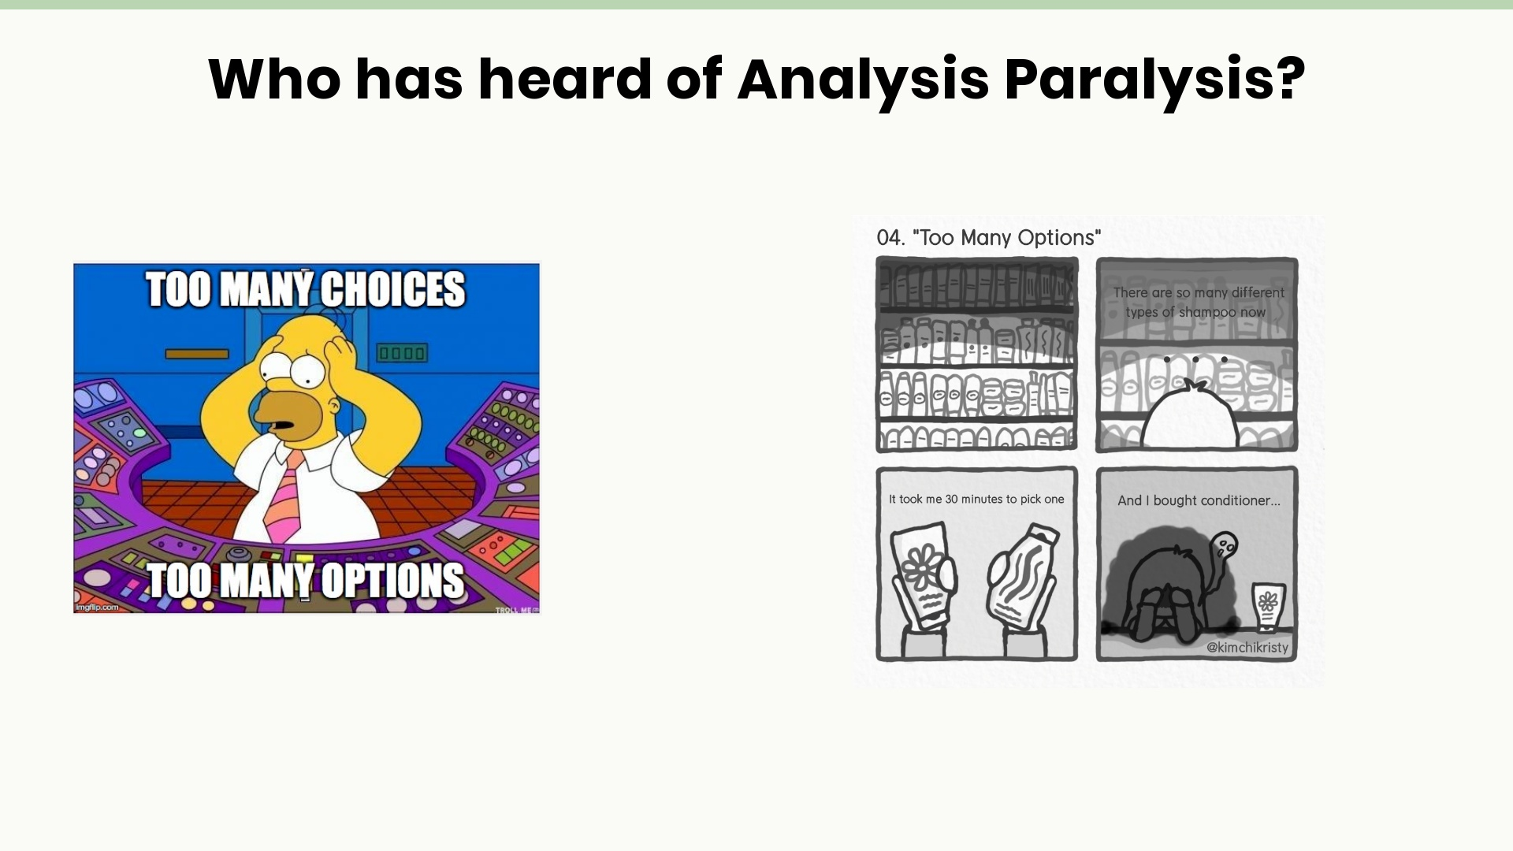
Notes:
Objective

Slide 7
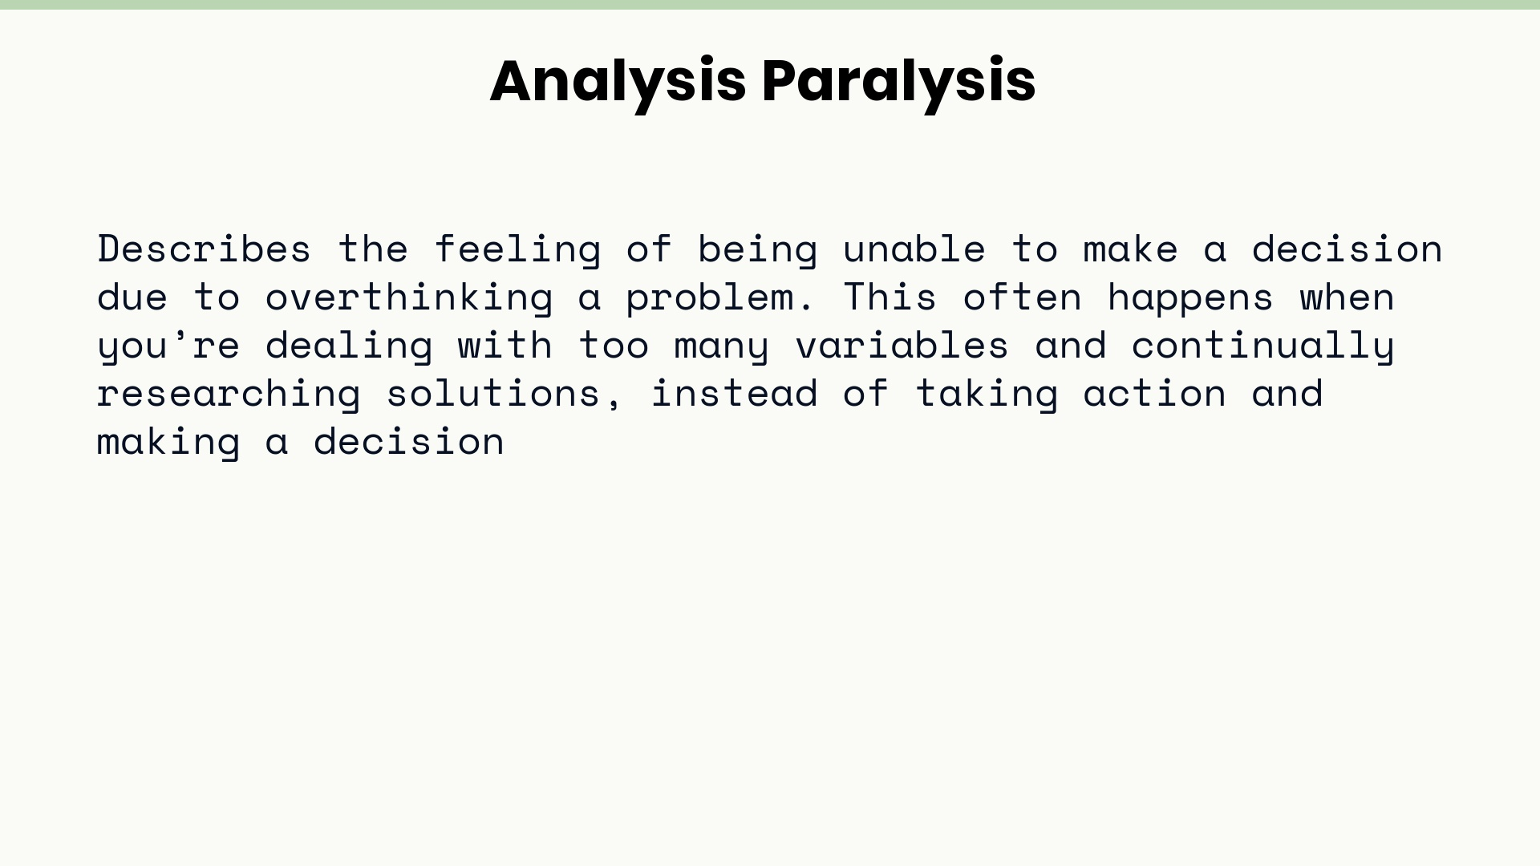
Notes:
Objective

Slide 8
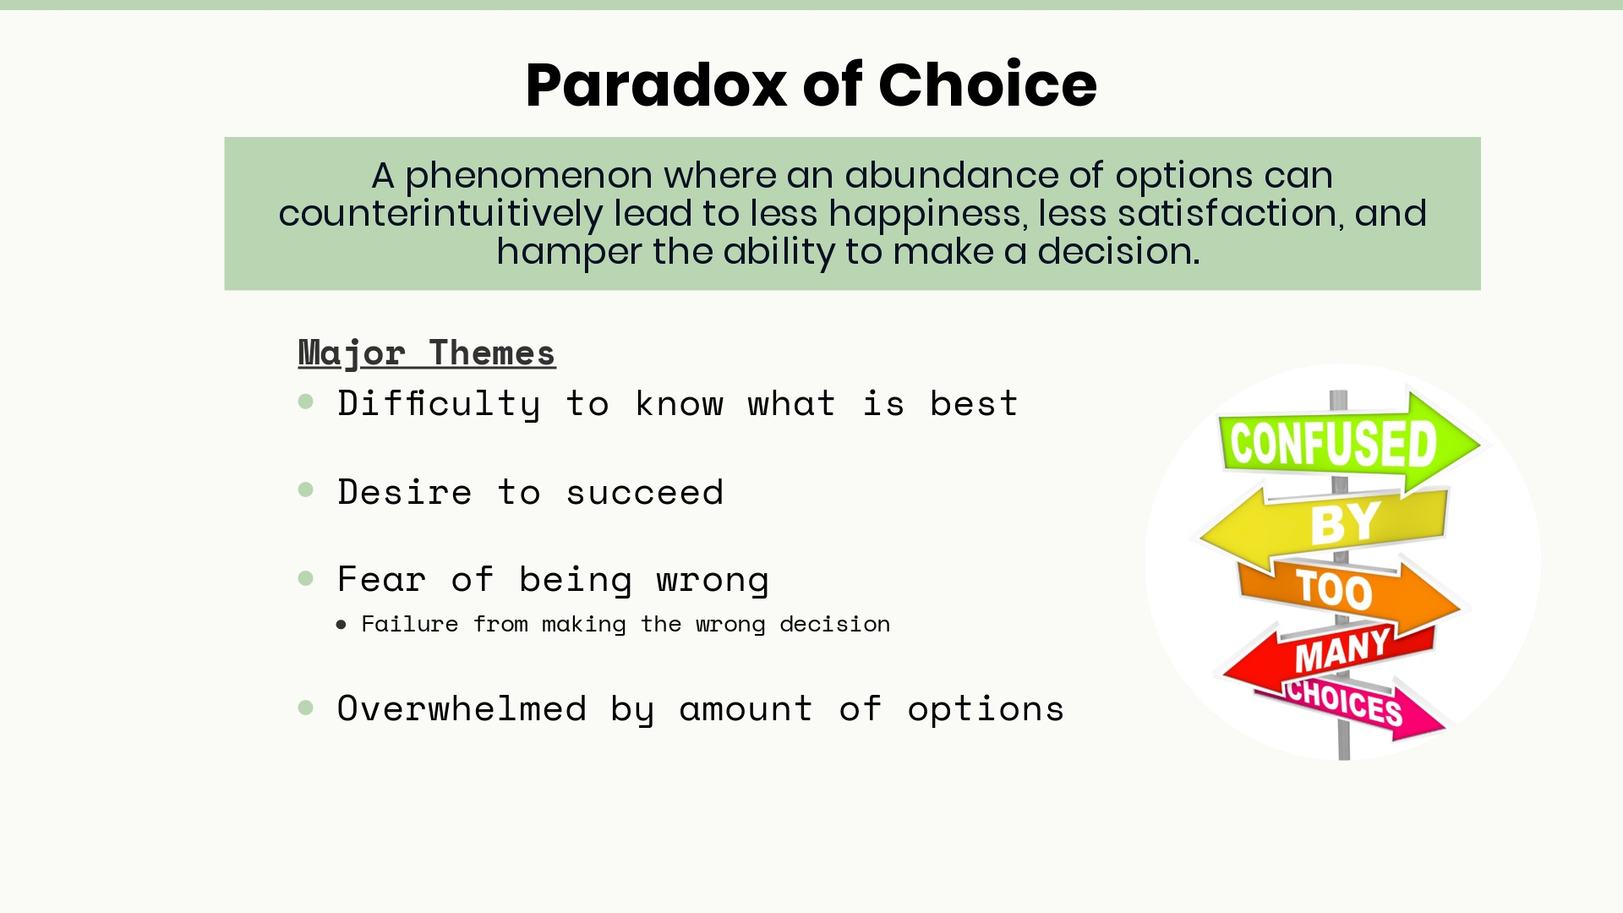
Notes:
Objective

Slide 9
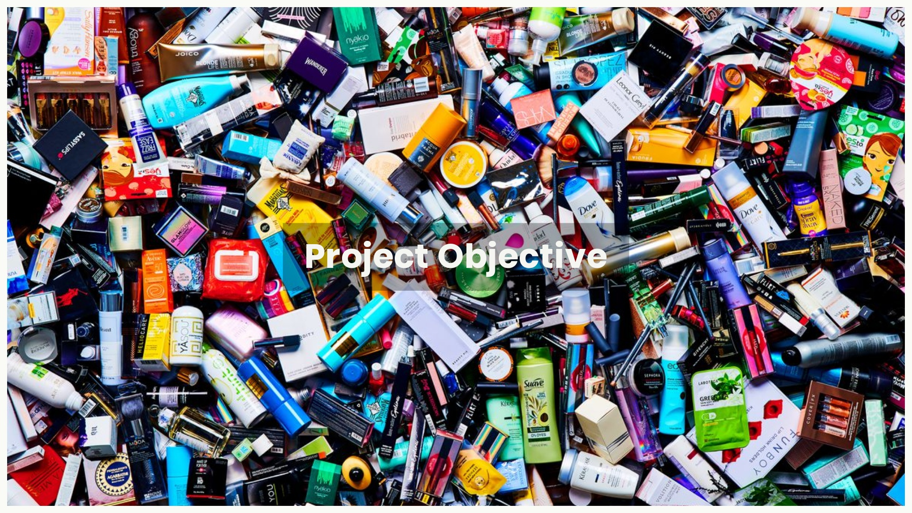
Notes:
Objective: To avoid this feeling of overwhelmed clutter

Slide 10
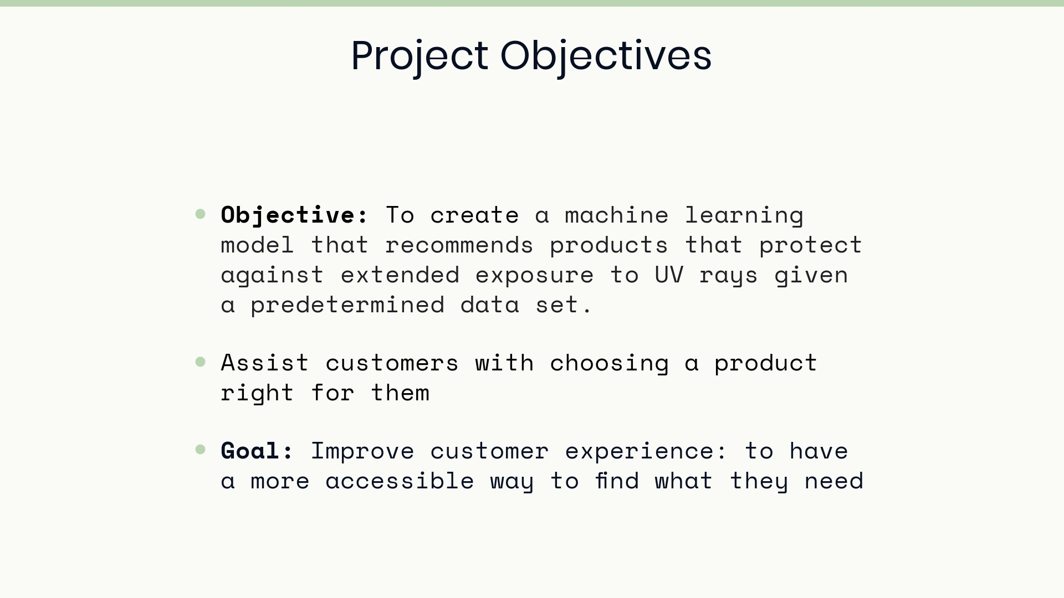
Notes:
Objectives: NEEDS EDITING

Slide 11
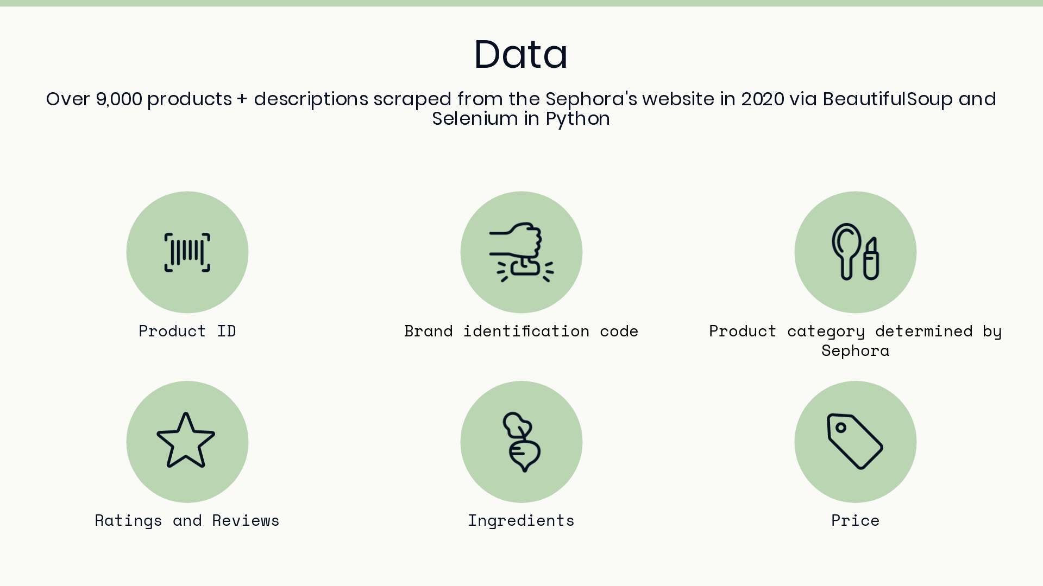
Notes:
Data

Slide 12
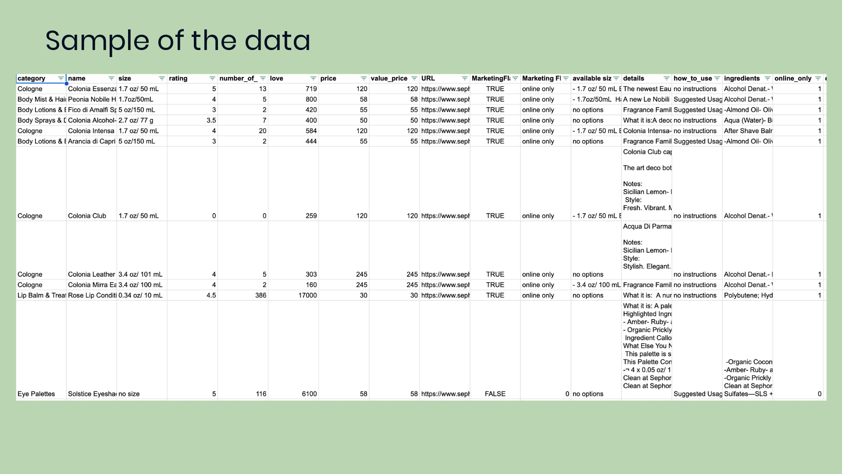

Slide 13
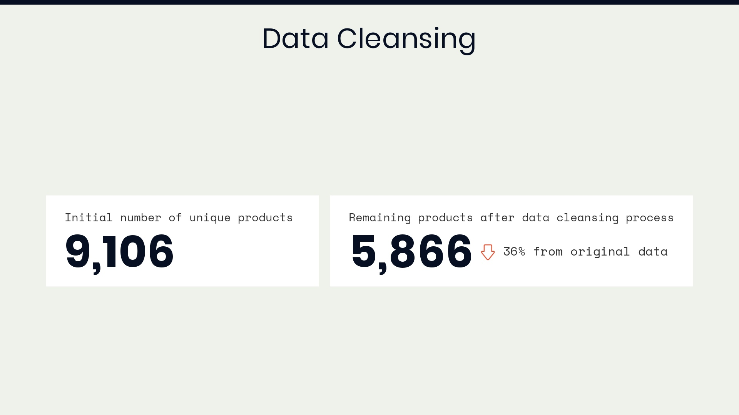

Slide 14
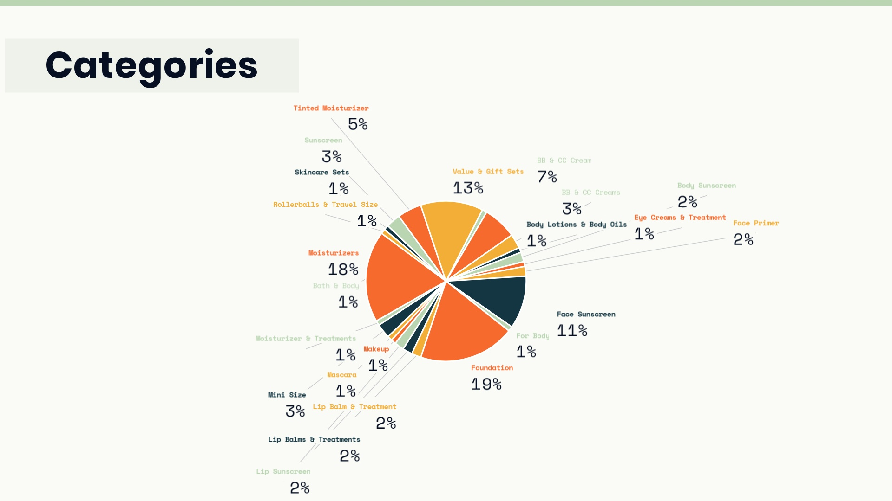

Slide 15
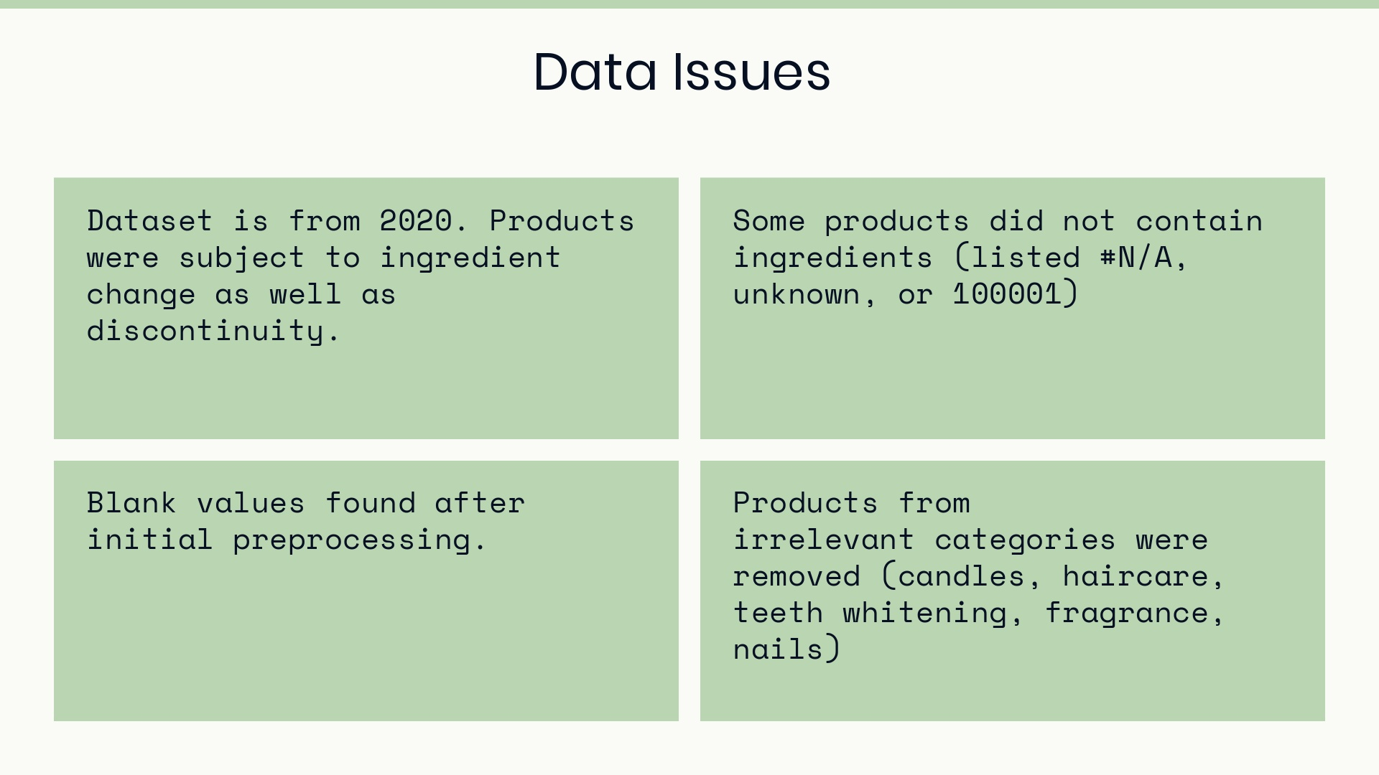
Notes:
issues encountered during data collection

Slide 16
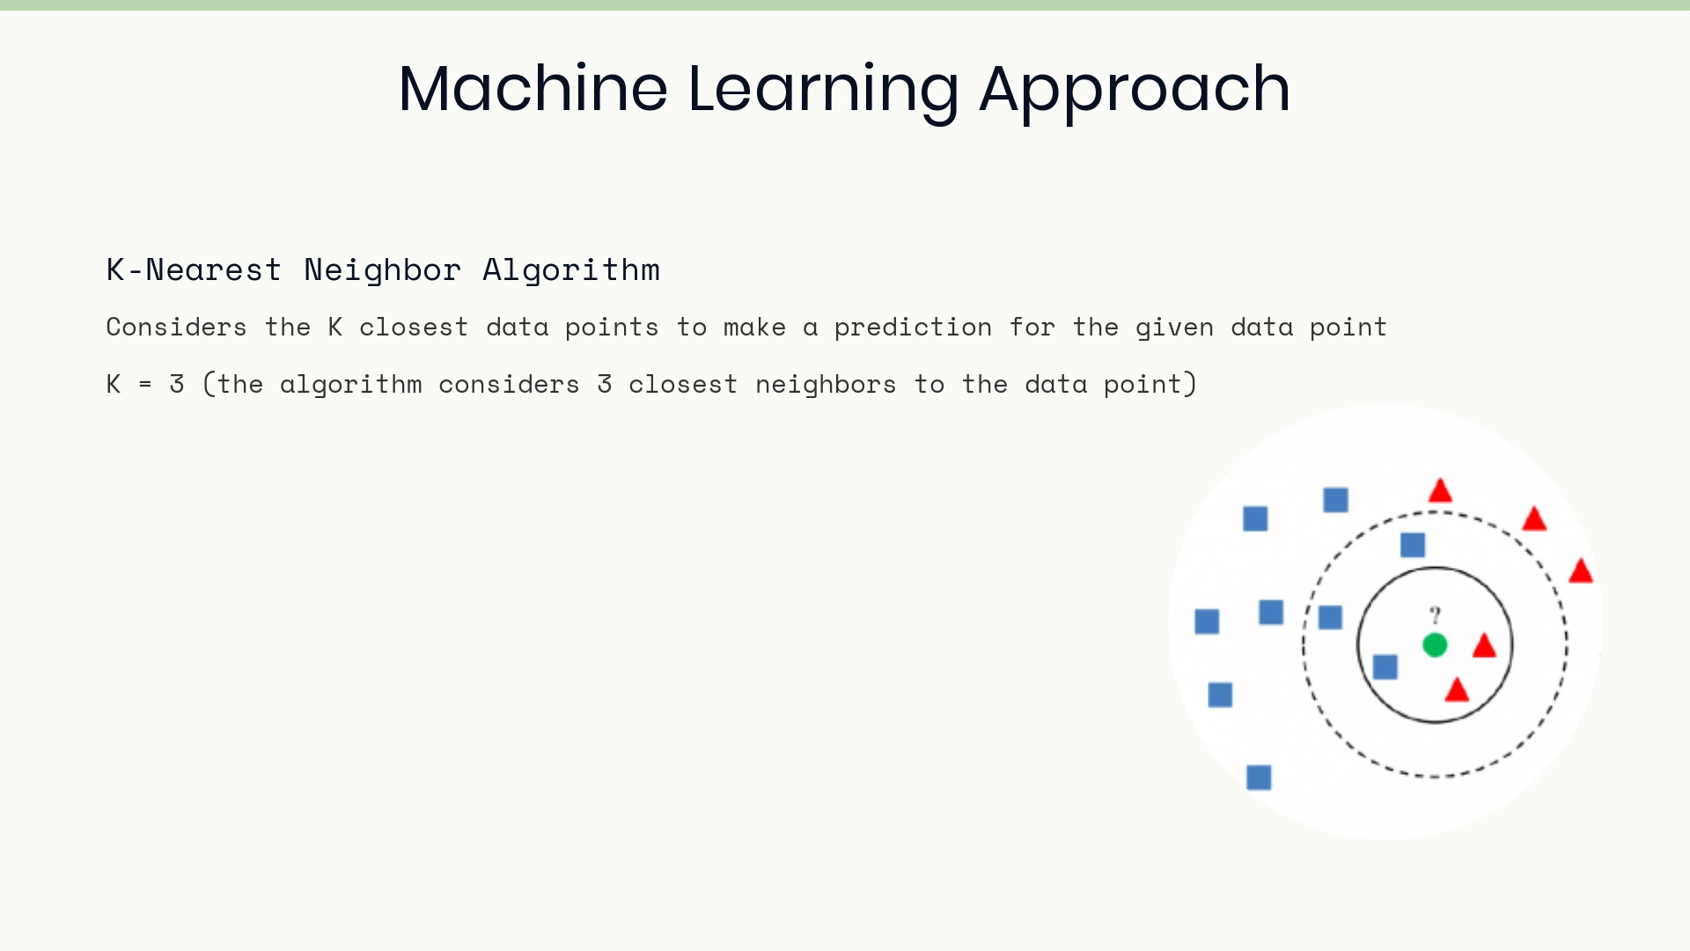

Slide 17
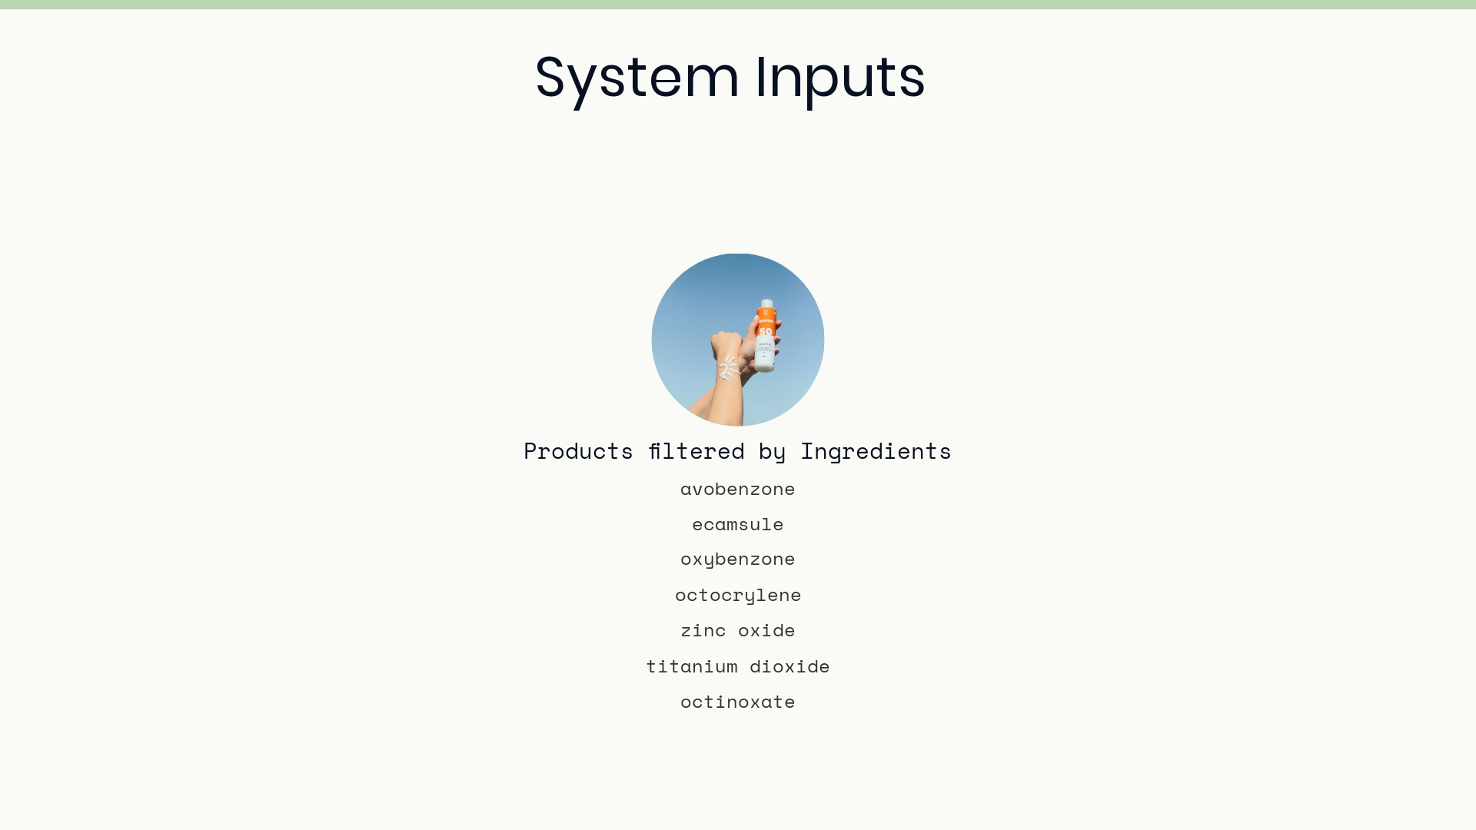

Slide 18
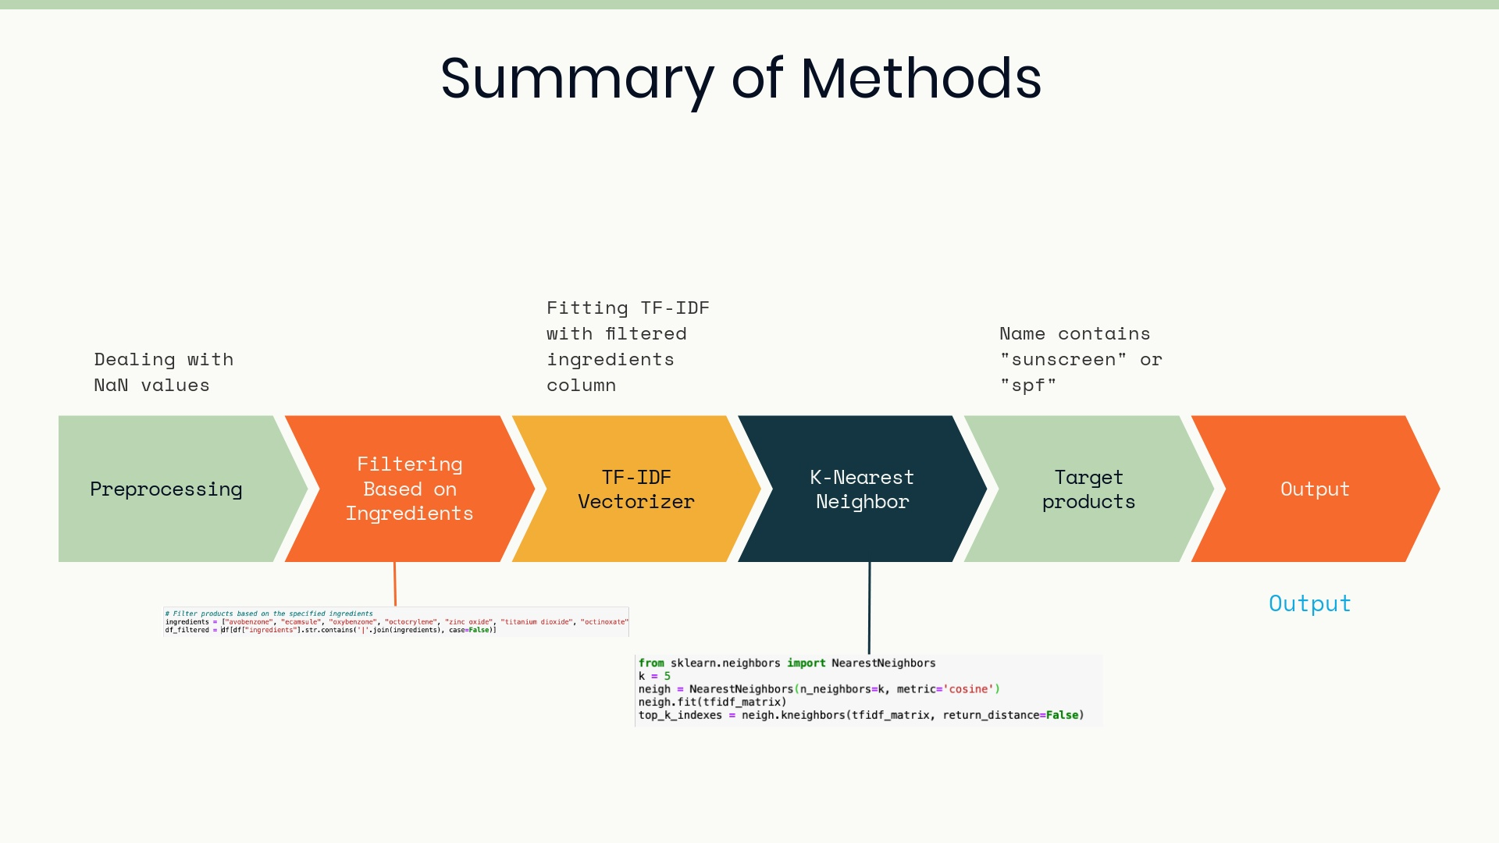
Notes:
Approach: A detailed description of your approach, e.g., the algorithm/methodology you used, highlighting any original contributions.

Slide 19
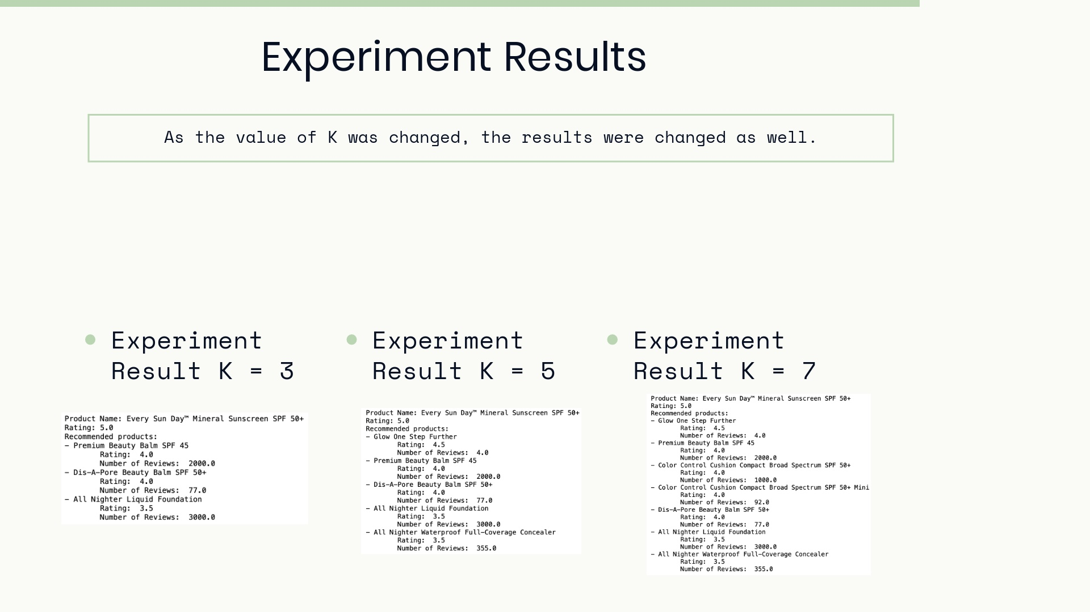
Notes:
Experiments and results: a description of the experiments you ran, presentation of results, comparison with baselines and alternative methods (in any), discussion of results (accuracy, but also issues related to efficiency, scalability, etc.)

Slide 20
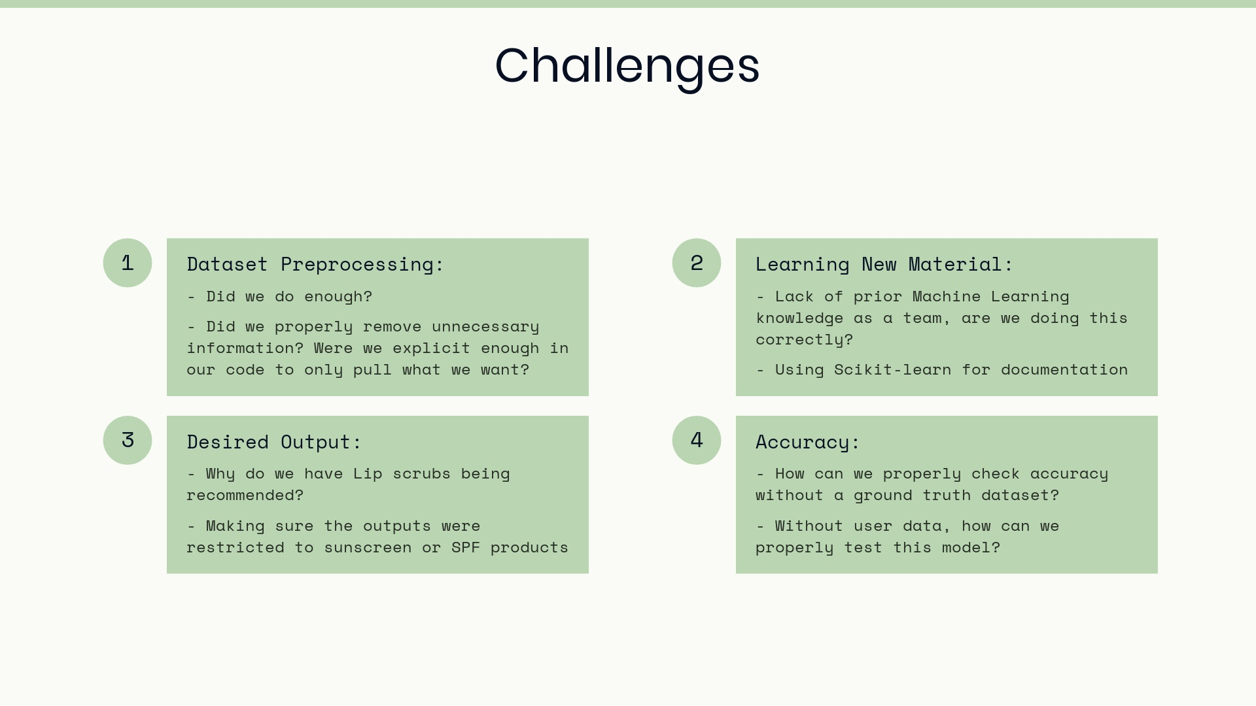
Notes:
Challenges

Slide 21
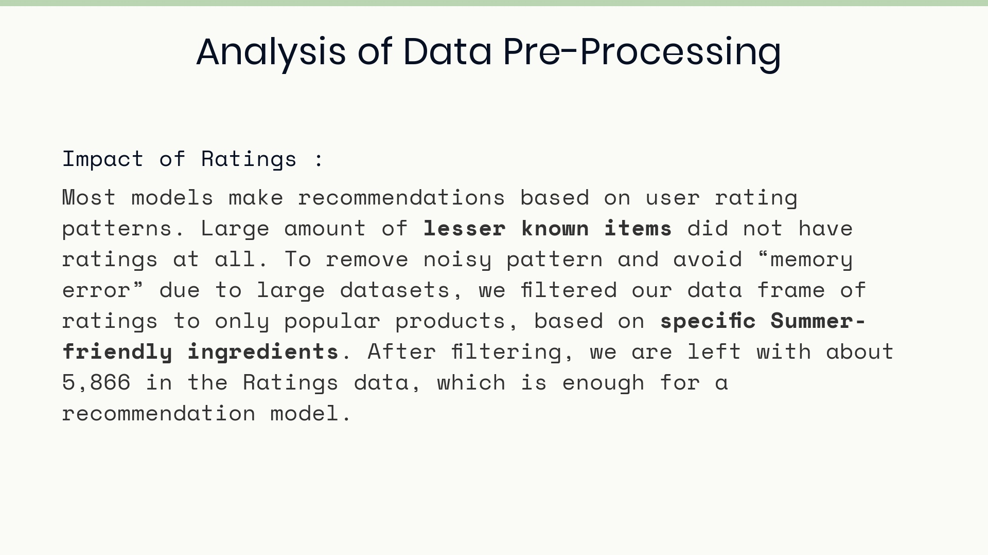

Slide 22
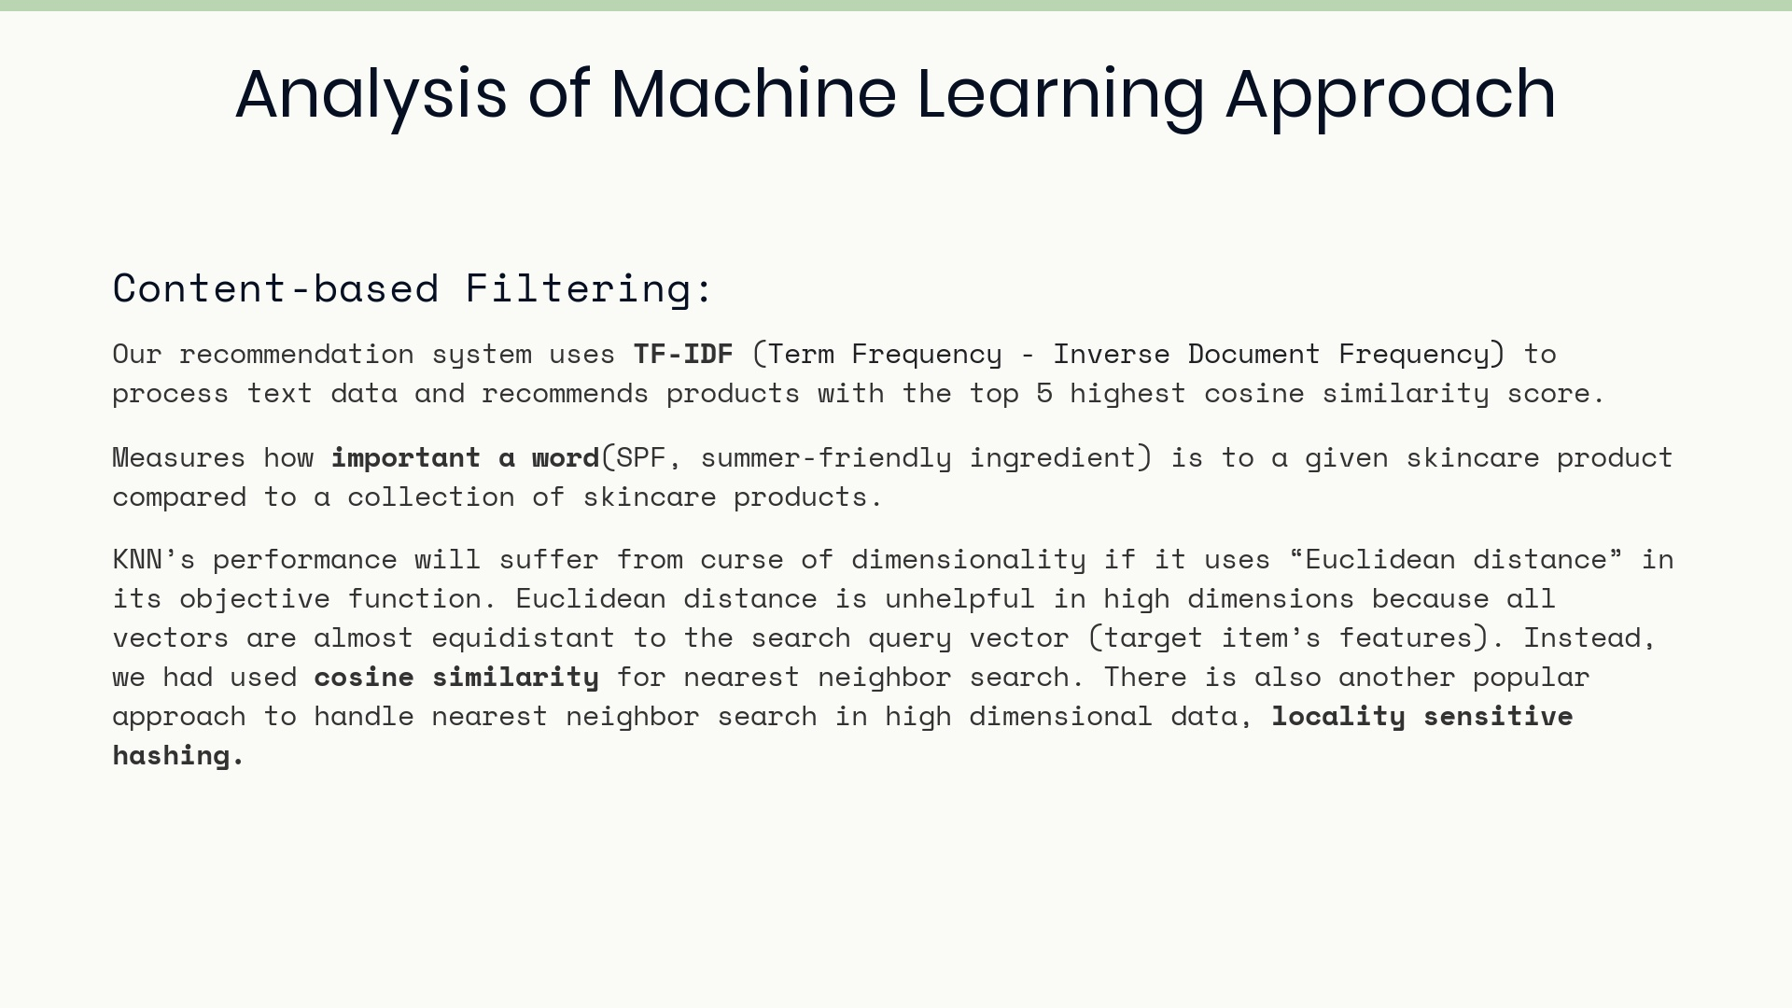

Slide 23
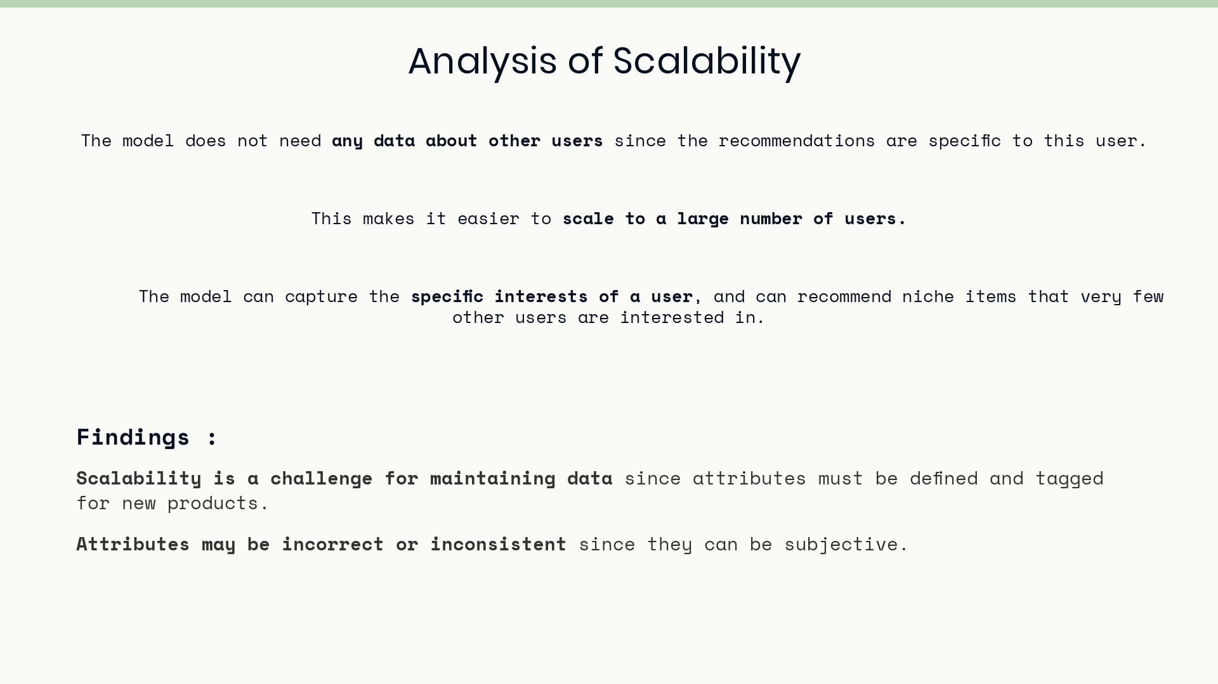

Slide 24
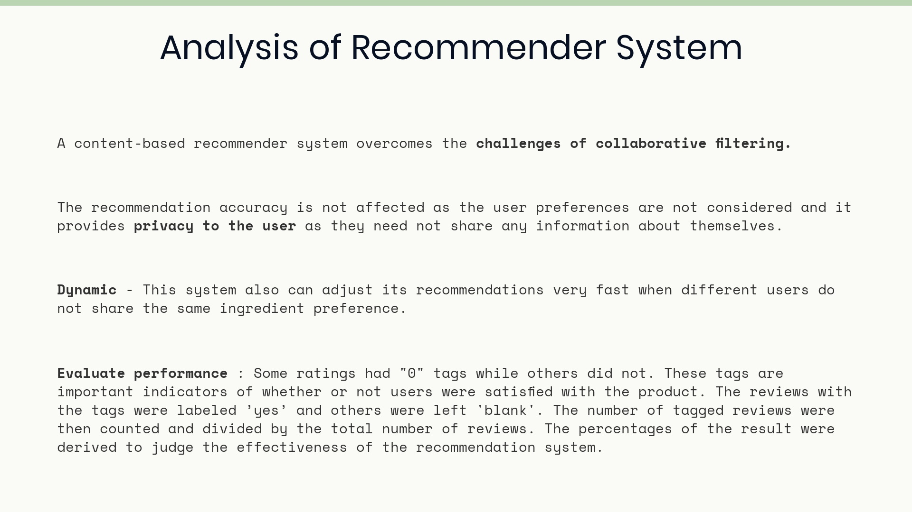

Slide 25
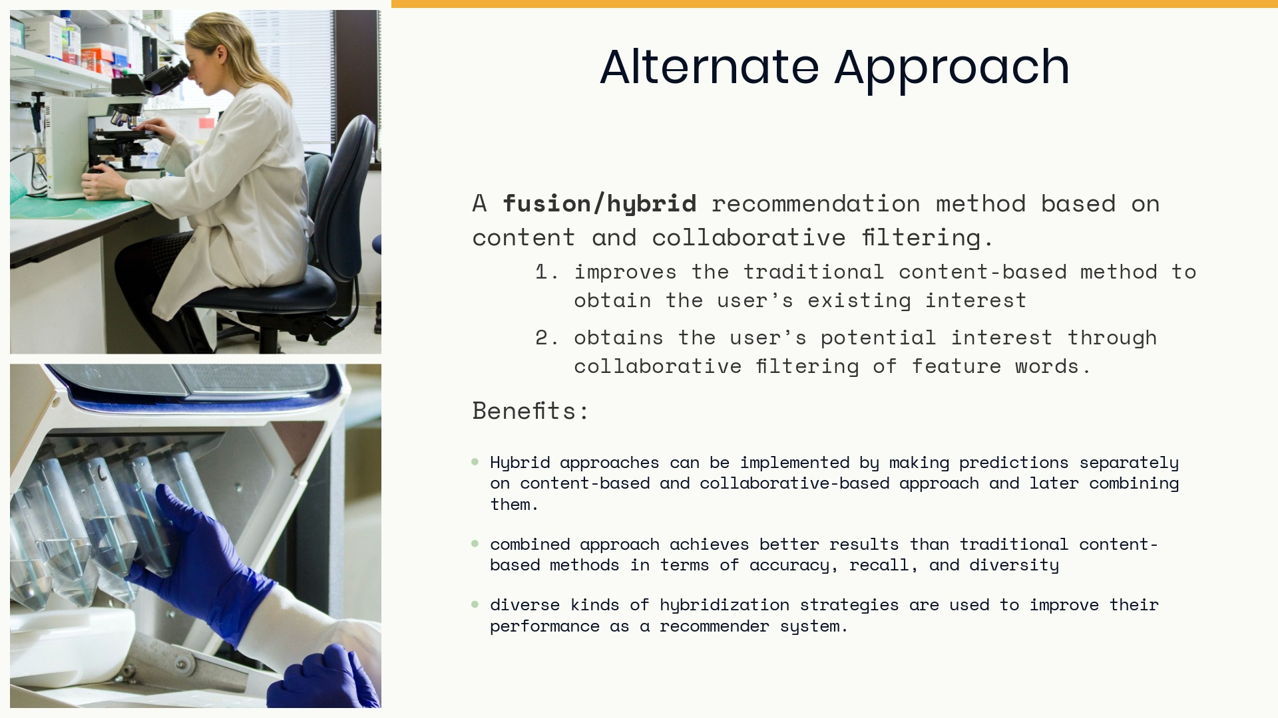
Notes:
Conclusions: main contributions of your project, what worked and what did not work, considerations for future work

Slide 26
